Slide 1
Personas
18F PROPOSAL

Slide 2
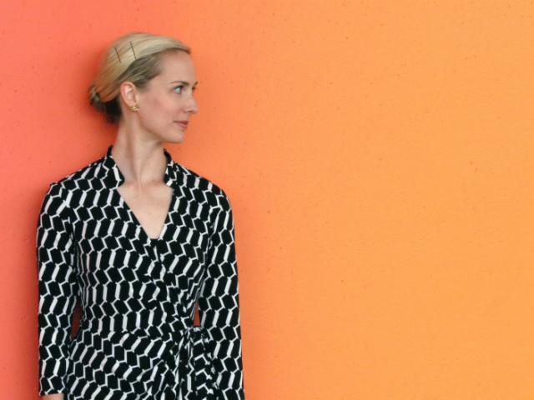

User Persona : Client Manager
Objectives:
Awareness/education around health concerns.
Gain ability to ask questions to their health practitioner.
Obstacles:
The less technically savvy you are the harder it is to use.
Need to ensure that results are clearly interpreted so that they are used properly.
Doctors who don’t want to be probed by patients.
Pharmaceutical companies attached to incidents with specific drugs.
Supplement understanding by seeing what has happened to my fellow citizens (huge population of reported incidents)
User Persona: Senior Citizen
Background:
May have multiple drugs prescribed by multiple doctors for a multitude of ailments.
Aged 75
Uses the internet for email but requires assistance with unfamiliar websites and applications.
Background: Working for 25+ years in Telecomm. Knowledgeable of software development process. Mostly done development work on large scale government Waterfall Projects.

Slide 3
User Persona : Client Manager
Objectives:
Awareness/education around health concerns.
Gain ability to ask questions to their health practitioner or to the medical providers for their loved ones
Gain ability to help elderly loved ones make informed decisions.
Obstacles:
Doctors who don’t want to be probed by patients.
Pharmaceutical companies attached to incidents with specific drugs.
Supplement understanding by seeing what has happened to my fellow citizens (huge population of reported incidents)
User Persona : Concerned Citizen
Background:
Age 50
May have multiple drugs prescribed by multiple doctors or have a loved one with prescription concerns.
They have concerns about friends/family/themselves with drug usage.
Moderately tech savvy when it comes to using the internet for research.
Has a curiosity about reported reactions to drugs and drug combinations.
Background: Working for 25+ years in Telecomm. Knowledgeable of software development process. Mostly done development work on large scale government Waterfall Projects.

Slide 4
User Persona : Client Manager
Objectives:
Awareness/education around health concerns.
Gain ability to ask questions to their health practitioner.
Obstacles:
Doctors who don’t want to be probed by patients.
Pharmaceutical companies attached to incidents with specific drugs.
Supplement understanding by seeing what has happened to my fellow citizens (huge population of reported incidents)
User Persona: Generation Y User
Background:
Age 23
May have multiple drugs prescribed by multiple doctors.
May be curious about reported reactions to drugs and drug combinations.
Grew up using the internet and is very tech savvy.
Background: Working for 25+ years in Telecomm. Knowledgeable of software development process. Mostly done development work on large scale government Waterfall Projects.

